Slide 1

Bank Management System
Department of CE/IT
Mini project OODP ( 01ce1303 )
To : Prof. Ankita Chavda
Name : Shivanand Vishwakarma
Class : TC – 1 Enrollment No. : 91900103021

Slide 2

Introduction
So basically my project (Bank Management System) is about how Bank works. Just a small overview of it.
Here in this project, you will be able to create your account, add money, withdraw money and many things that you will see later in this PPT.

Slide 3
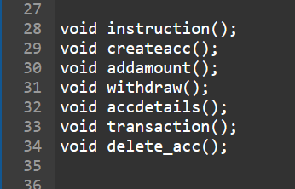
Functionality
Total 7 Functions are created in this project
For Instruction
For Create Account
For Add Amount
For Withdraw
For Account Details
For Transaction from Account to Account
For Delete Account

Slide 4
Strength of project
Reason for selecting this definition :
First of all, I found myself good and capable to make this project.
Once I also tried to make project on this topic, Hence I have a bit more knowledge on this topic.
Advantages :
I guess, the most advantage thing about this project is we will get to know about how Bank works and their ways to deals with customers.

Slide 5

How this project is helpful :
As I mentioned that via this project, we can get a knowledge (little knowledge) how Bank works and how your money deposited and withdrawn.
Mostly, people from rural areas have no idea about how Bank works and how it’s really important to have knowledge about it. This project will little guide them.

Slide 6
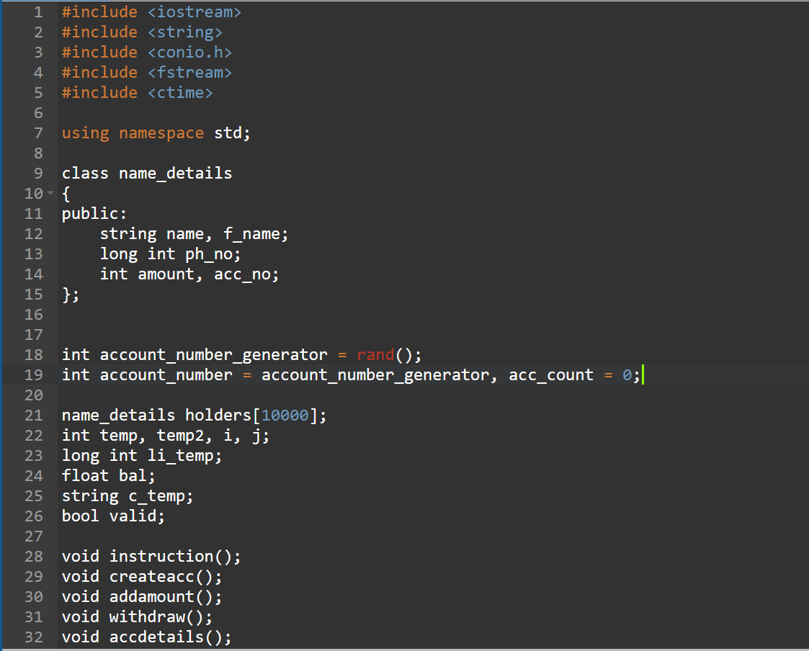
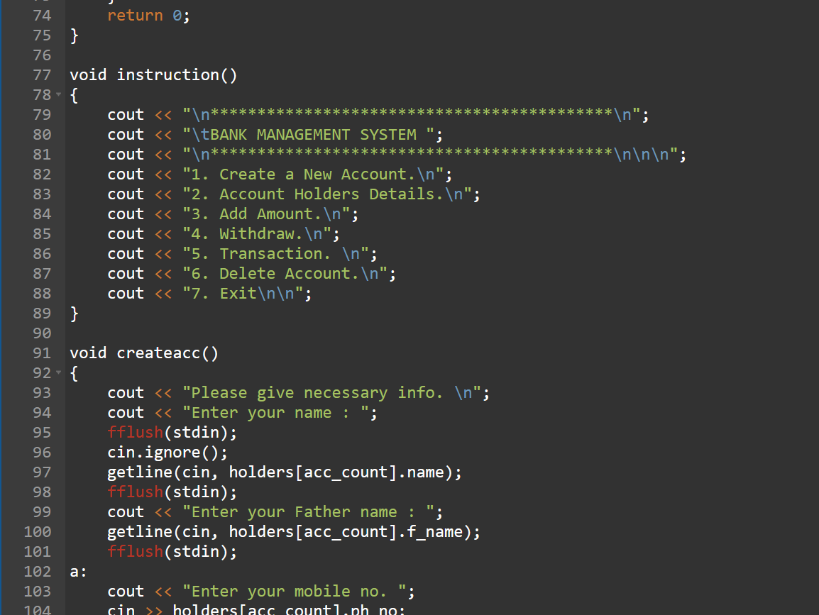
Sample coding screenshots

Slide 7
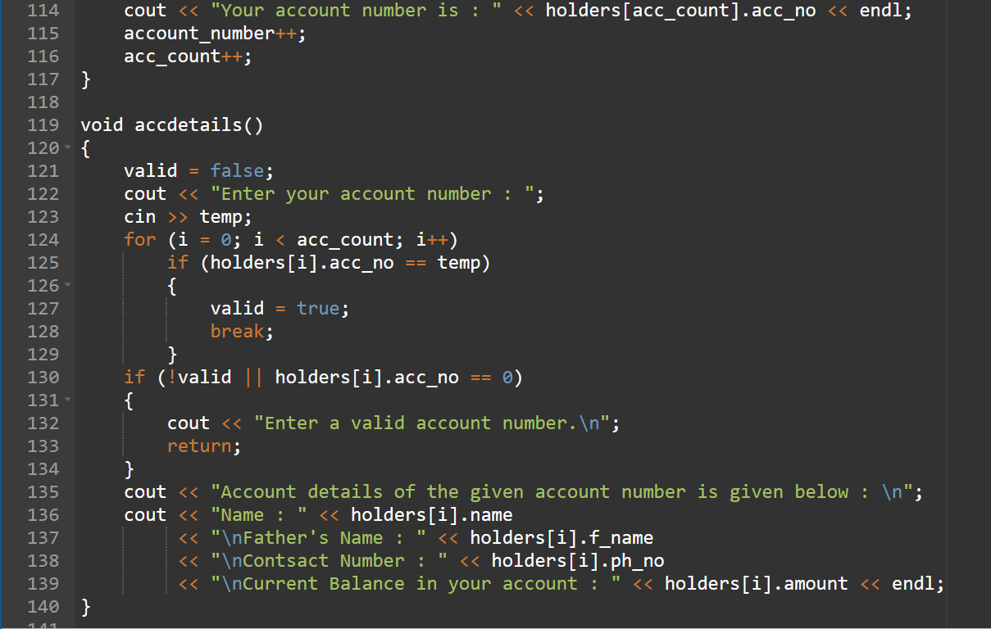
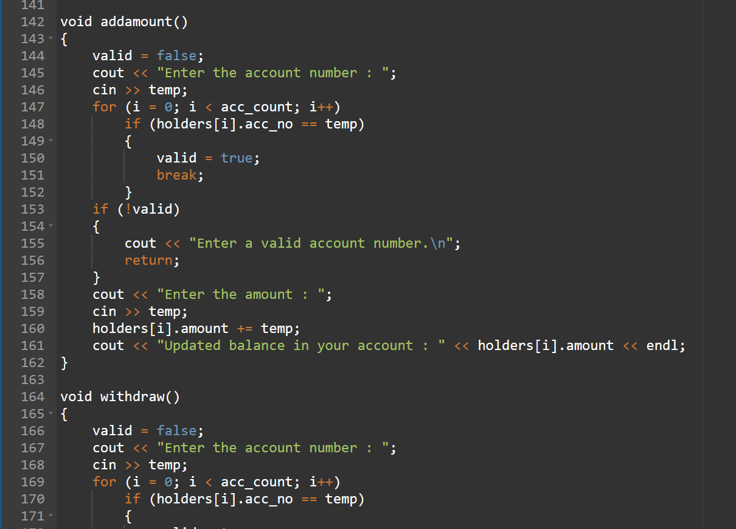

Slide 8
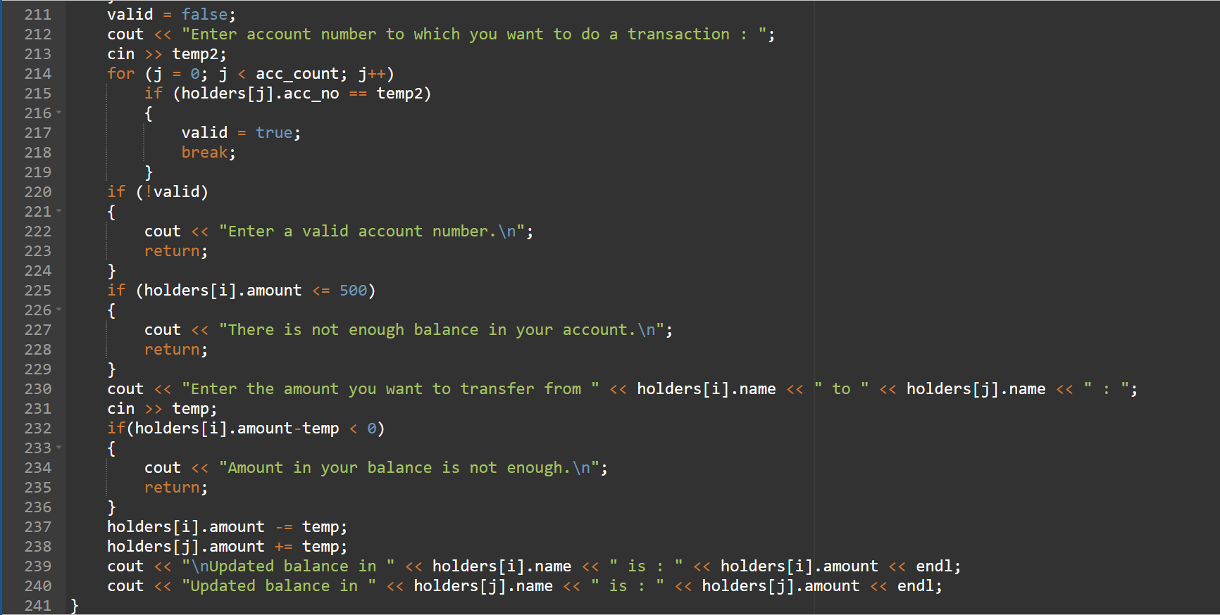

Slide 9
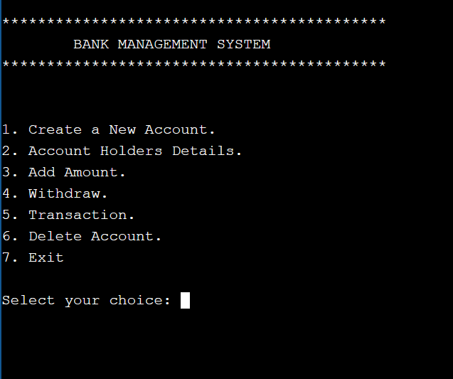
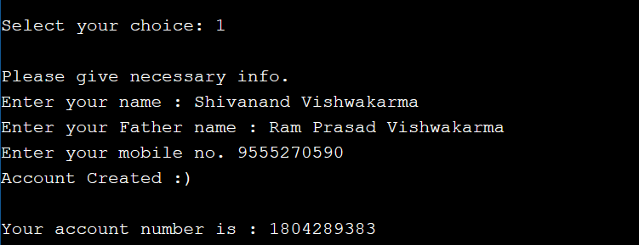
Sample coding screenshots
1st Function :
Here, Account Number generated automatically.

Slide 10
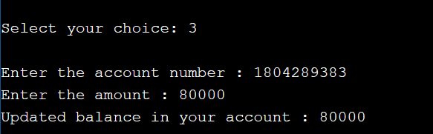
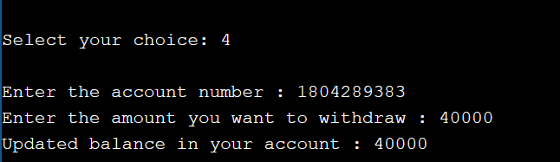
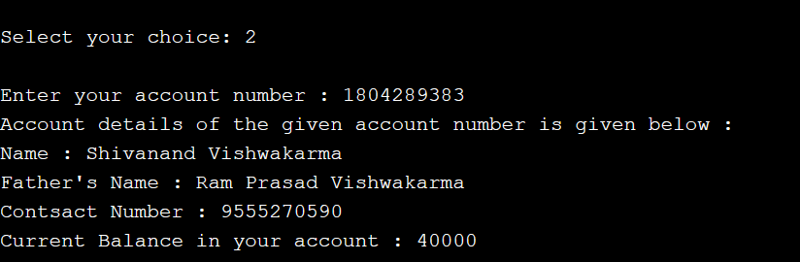
2nd Function :
3rd Function :
After entering Account Number & Amount, it will update the balance in the account.
After entering Account Number & Amount, it will reduce the amount and update the balance in the account.
4th Function :
After entering Account Number, it will all the details of the Account Holder.

Slide 11
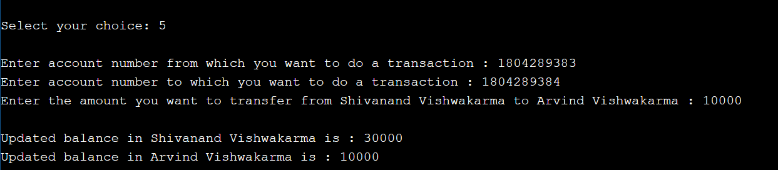
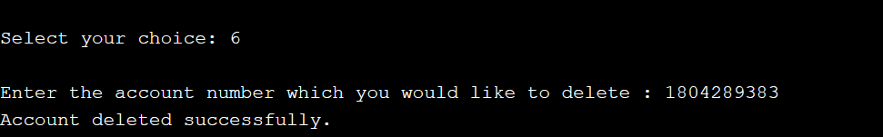
5th Function :
Here I created another account for transaction purpose with 0 amount at initially.
After filling details, Balance in both account will be updated.
6th Function :
After entering account number, it will directly delete that account.

Slide 12
limitation/extension
Limitation :
Not much details are there in this project.
A very simple program, not much functions.
Extension :
We can add some data like type of account (current/saving), some type of security feature like will ask password before getting details of any account, more functions like bank to bank money transfer and many more.

Slide 13
THANK YOU

